Slide 1
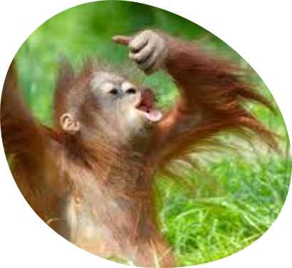
How does the climate change affect the fauna?
GROUP H

Slide 2
IMPACT OF CLIMATE CHANGE ON FAUNA
Changes in climate and weather may force species to migrate to new areas
The species that can't escape their newly inhospitable surroundings or adapt will die
Individual extinctions may compromise the delicate balance of natural world because species depend on each other

Slide 3
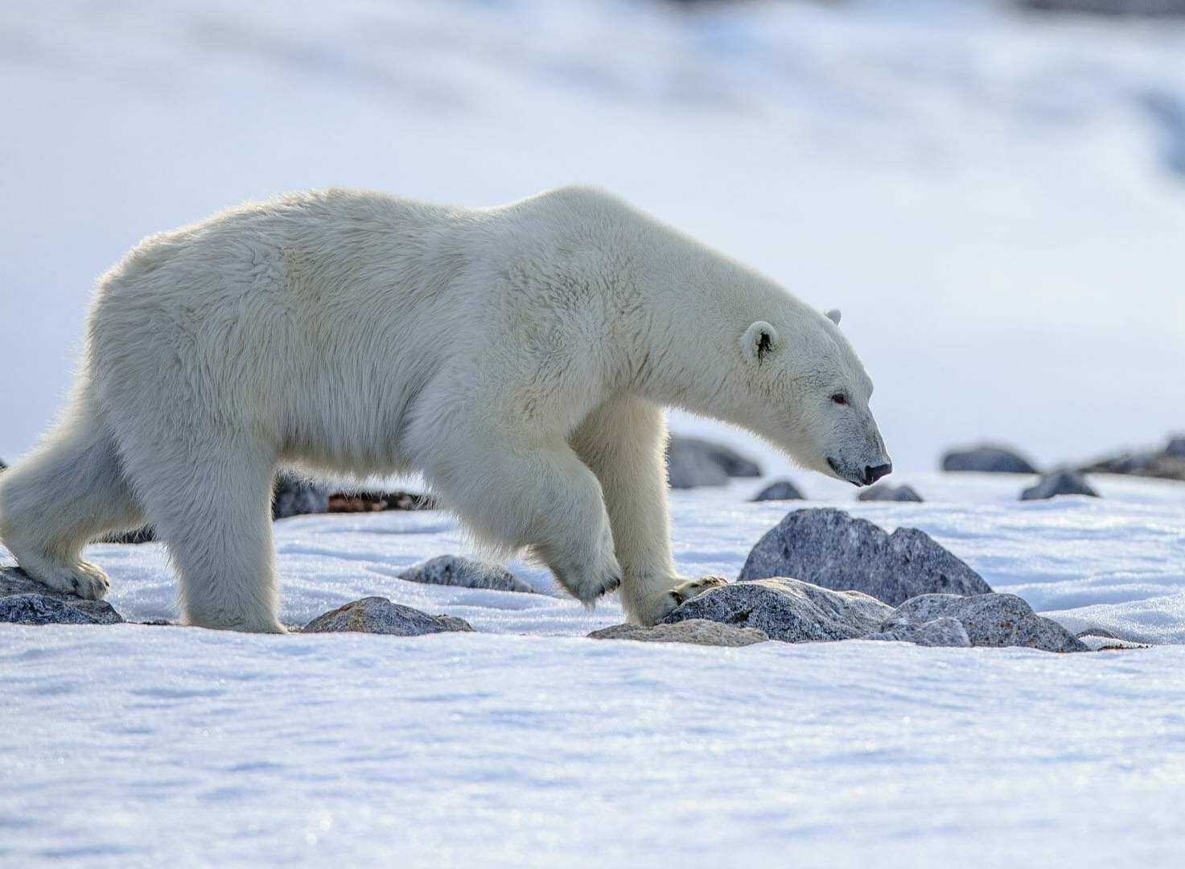
ARCTIC ANIMALS

Slide 4
POLAR BEARS
They are forced to live in a very small territory due to the reduction of ice surfaces
The movements are difficult because the ice sheets are thin and distant to each other
They have difficulties in finding food:
they are unable to accumulate the necessary grass to survive
they search food in the territories inhabited by man
higher puppy mortality
"The polar bears population could decrease by 30% in the next 35 years"

Slide 5
PENGUINS
They're losing their house and food because of ice sheets melting.
The scarcity of food forces young penguins to dive into the sea, when they aren't ready yet to face the frozen water and the attacks of predators.
"If the temperature increases further by 2 C°, 50
% of penguin colonies will disappear"

Slide 6
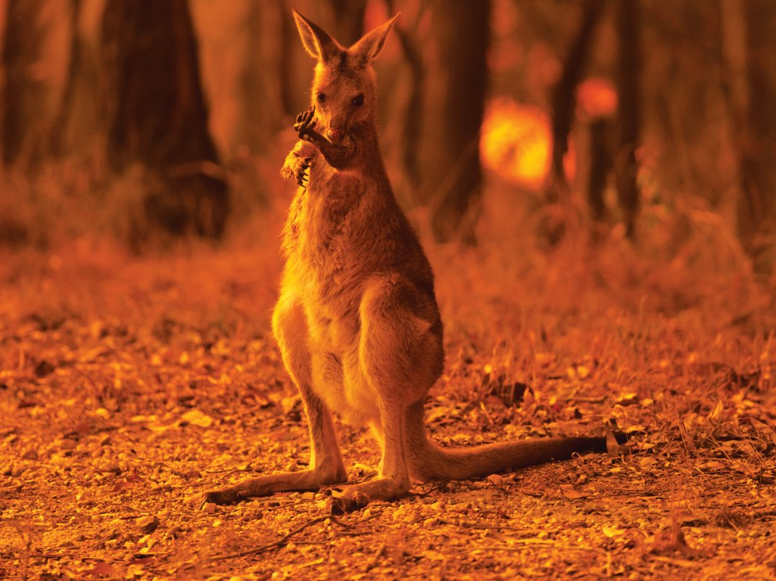
Australian wildfire

Slide 7
WILDFIRES
The wildfires burn down the forests which is home to a lot of animals.
The enviroment also gets drier so the fire spreads faster.
3 billion animals died in the fire, thats 1852 x more than people have died in corona.

Slide 8
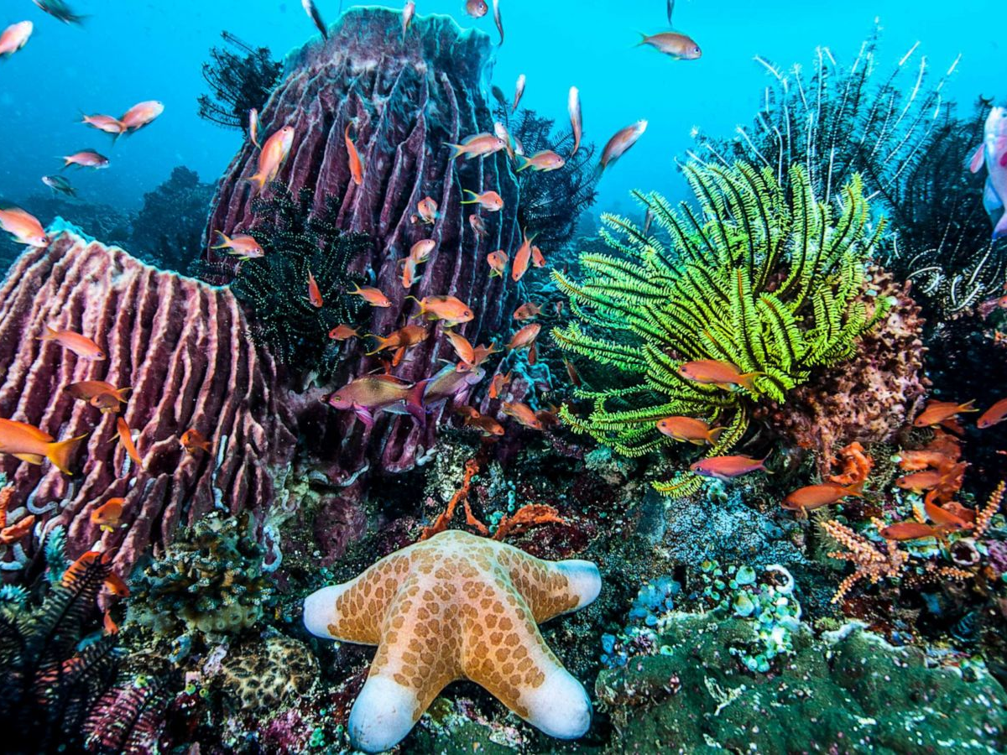
SEA and OCEAN

Slide 9
TURTLES
The temperature at which the eggs of the turtles are incubated determinise their sex.
Usually at the higher temperatures born more females.
Due to global warming is taking place a "feminization" so the possibility of mating is lower.

Slide 10
CORAL REEFS
Because of the CO₂ emissions the ph-level in the oceans are getting lower so the coral reefs die. The reefs are home to alot of species that, because of this, might die.
"Over 50% of the world's coral reefs have already died in the last 30 years"

Slide 11
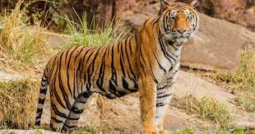
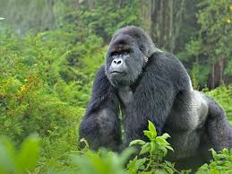
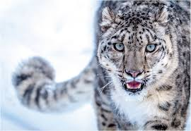
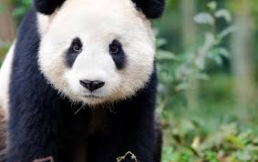
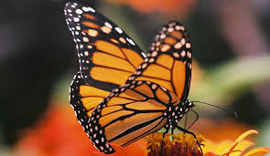
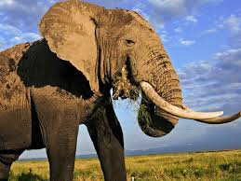
OTHER ANIMALS AFFECTED BY CLIMATE CHANGE
Snow Leopard
Tiger
Mountain Gorilla
Monarch butterfly
Elephant
Giant Panda

